Slide 1
Multitier - Exercises
Describe the main characteristics of a 2-tiers architecture and give diagram for 1 concrete example of such an architecture
Describe the main characteristics of a 3-tiers architecture and give diagram for 1 concrete example of such an architecture
What are the main advantages and drawbacks when moving from 2-tiers to 3-tiers architectures?
Give one example of a 4-tiers architecture and explain why it is sometimes chosen over the 3-tiers one

Slide 2
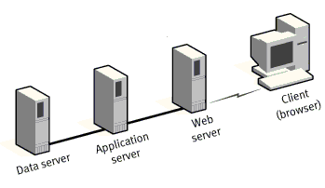
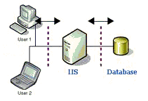
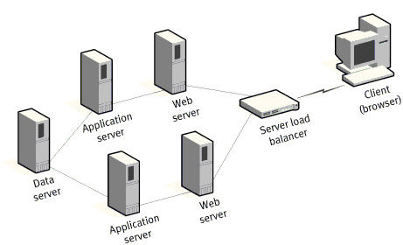
Multitier - Exercises
How many tiers are there in the following applications

Slide 3
Multitier - Exercises
What are the main differences between fat and thin clients?
What are the fundamental differences between traditional 3-tiers and SPA (Single Page Application)? For each type, please list 3 popular technology stacks usually used to implement them.
Notes:
Hints: Traditional 3-tiers is the classical web page like mentioned at http://www.eikospartners.com/blog/multi-page-web-applications-vs.-single-page-web-applications

